Slide 1
Sales Dataset Analysis – Advanced Excel Project
GURUPPRASATH K
12.12.2024
Data analytics & Data Science
Oct 2024(regular)

Slide 2
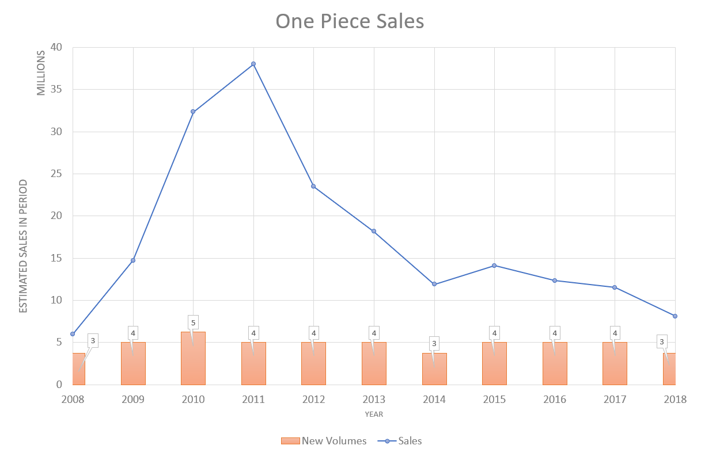
Project Overview To analyze sales data to identify trends, understand sales performance, and provide actionable business insights.
OBJECTIVES
Analyze sales trends over time.
Identify high-performing products and sales channels.
Determine the impact of returns and discounts.
Create a dynamic dashboard with key metrics.

Slide 3
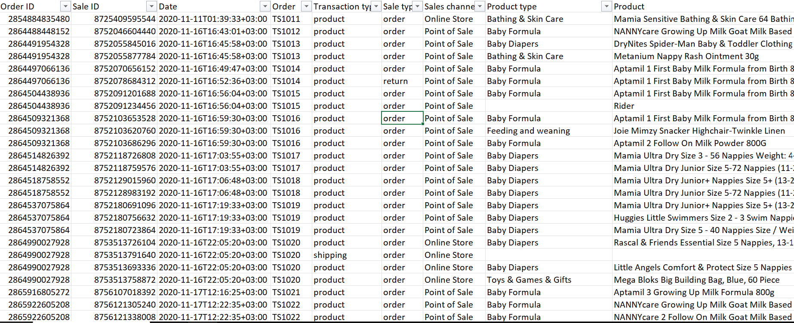
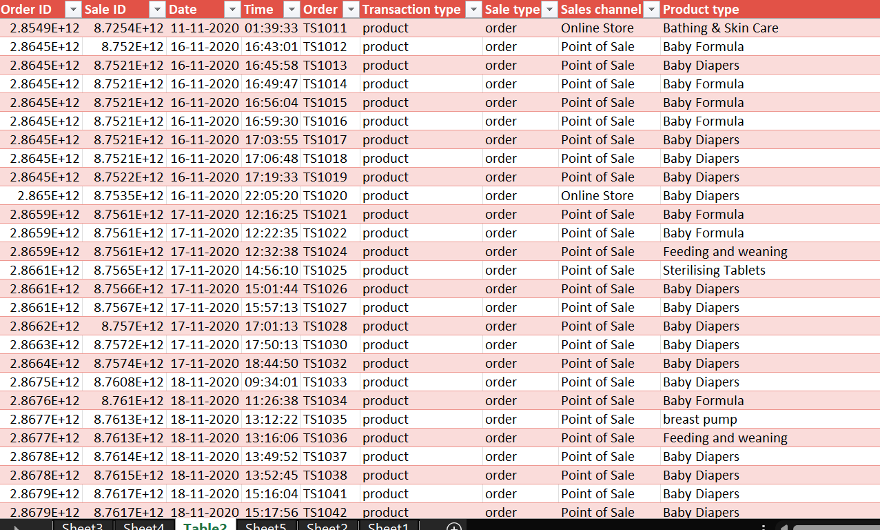
Data Set Overview
Data Cleaning
AFTER
BEFORE

Slide 4
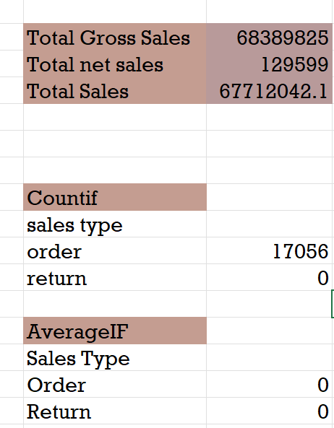
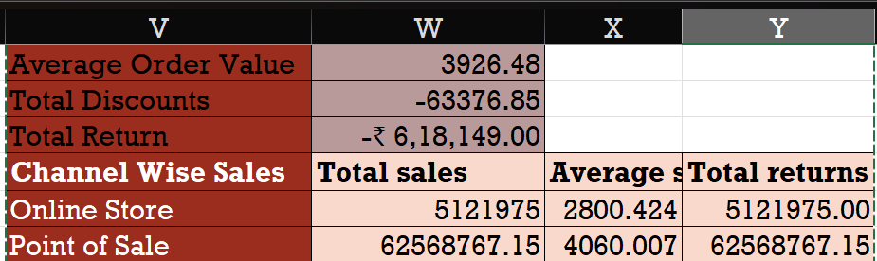
IMPORTANT CALCULATION
Total sales (Gross, Net, Adjusted)
Average sales per order
Discount rates, return rates
Sales by channel/product type

Slide 5
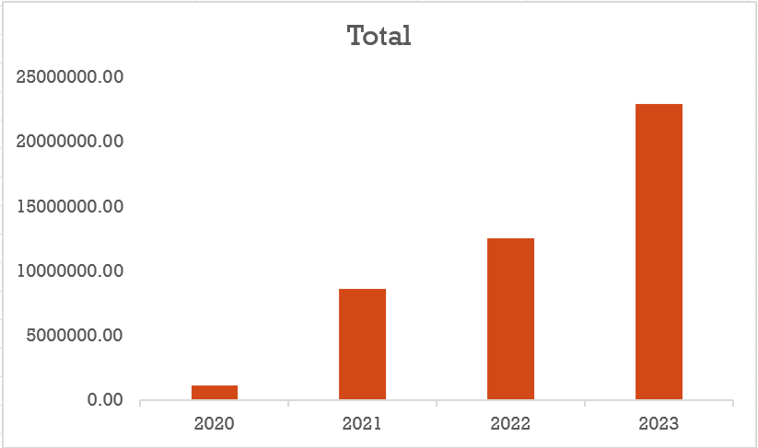
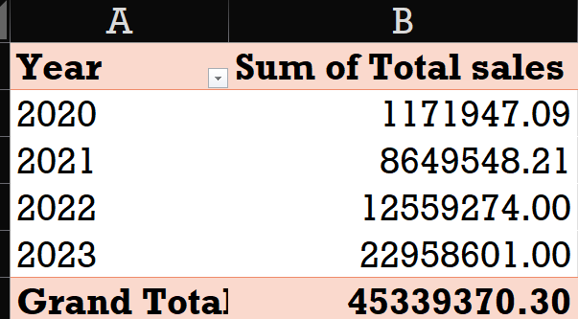
PIVOT TABLES AND CHARTS
Pivot Table Summary
Pivot Chart Visualizations

Slide 6
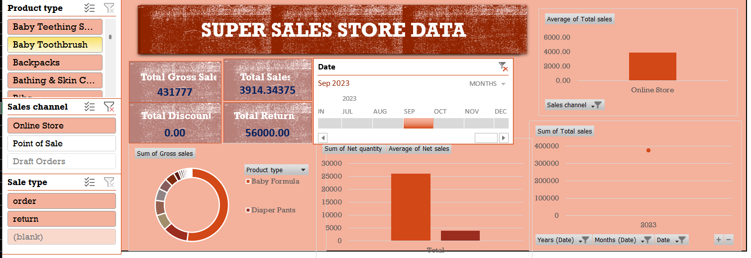
DASH BOARD

Slide 7
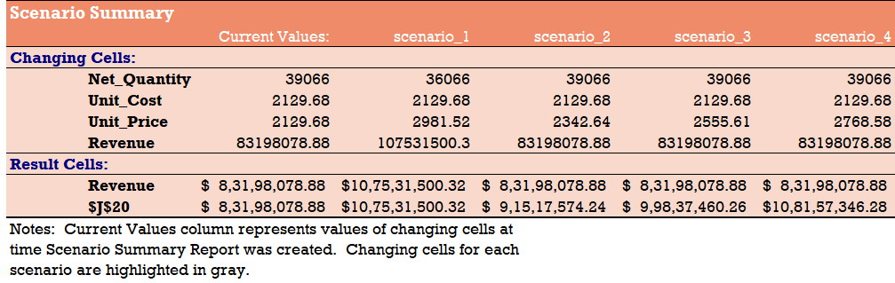
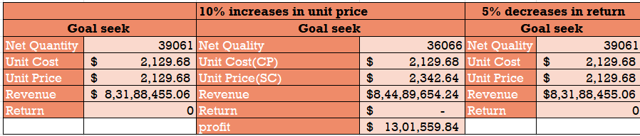
WHAT IF ANALYSIS
GOAL SEEK

Slide 8
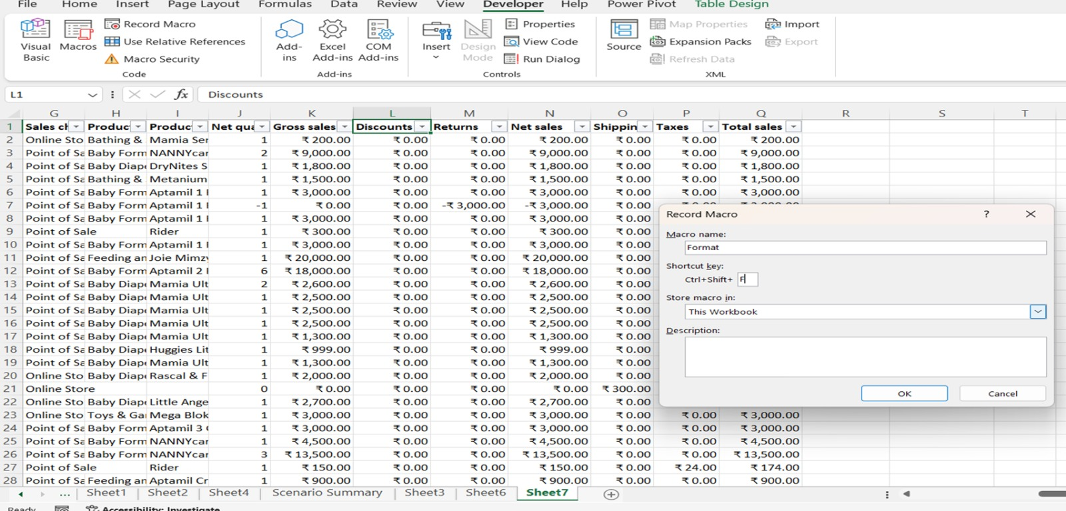
MACRO AND AUTOMATIONS

Slide 9
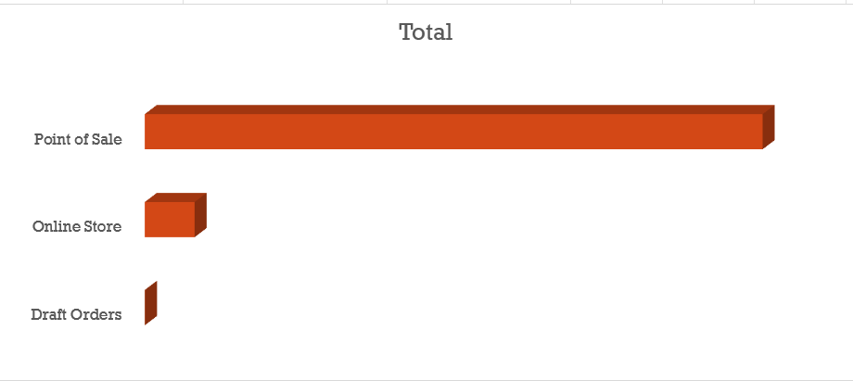
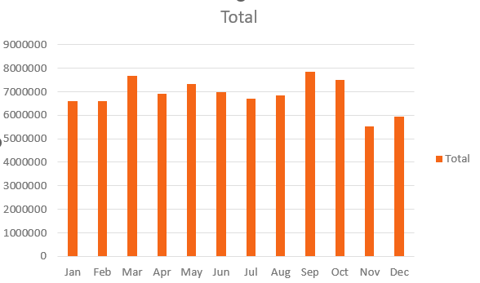
INSIGHTS
KEY INSIGHTS
Peak sales period 2023
Sales Channels-Point of sale
Focus on Online Store , Draft Orders

Slide 10
CONCLUSION
Focus on Draft Orders
Need to Improve in November and December months.
Baby Formula as the top-selling product with feeding and weaning products.
Top sales in September, with consistent year-over-year growth.

Slide 11


